Slide 1

OUR COMPANY:
-Francesco Romani francesco.romani5@studio.unibo.it
-Jacopo Ferretti jacopo.ferretti3@studio.unibo.it
-Mattia Davario mattia.davario@studio.unibo.it
-Rosario La Rocca rosario.larocca2@studio.unibo.it
-Tommaso Bertoncello tommaso.bertoncello@studio.unibo.it
Laboratory of Business Plan
15/12/2020

Slide 2
THE IDEA
«Do you own a container for your lunch or a bottle for your drink?»

Slide 3
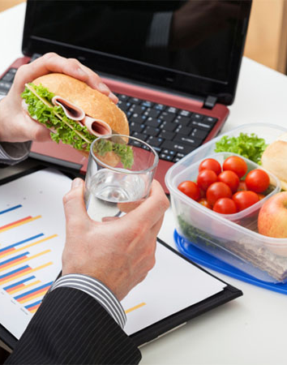
THE PROBLEM
Cold food
Space saving
Oil leakage
Pollution

Slide 4

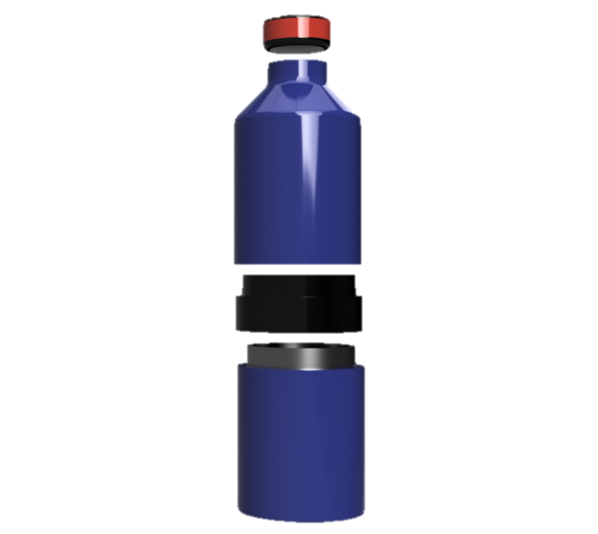

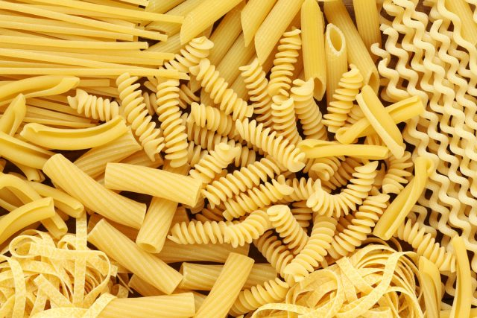
THE SOLUTION
WATER (0,5 l)
ISOLATION SPACE
FOOD (0,45 l)

Slide 5
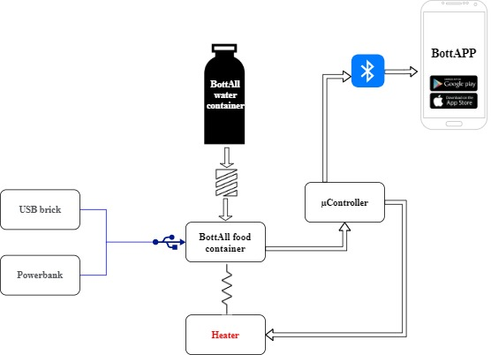
THE TECHNOLOGY
Double layer insulation
Resistance heater
Dedicated APP
USB-C technology
Temperature sensor

Slide 6
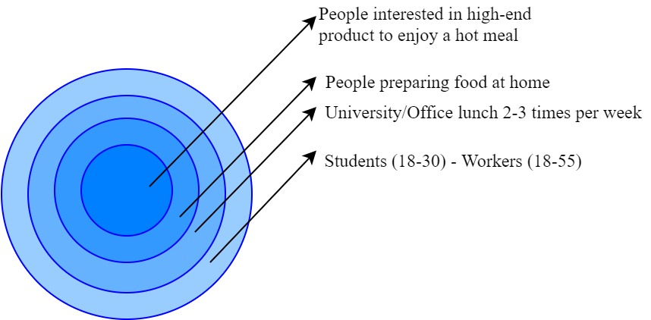
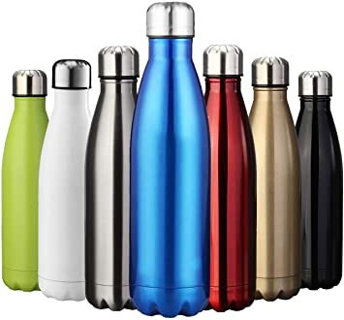
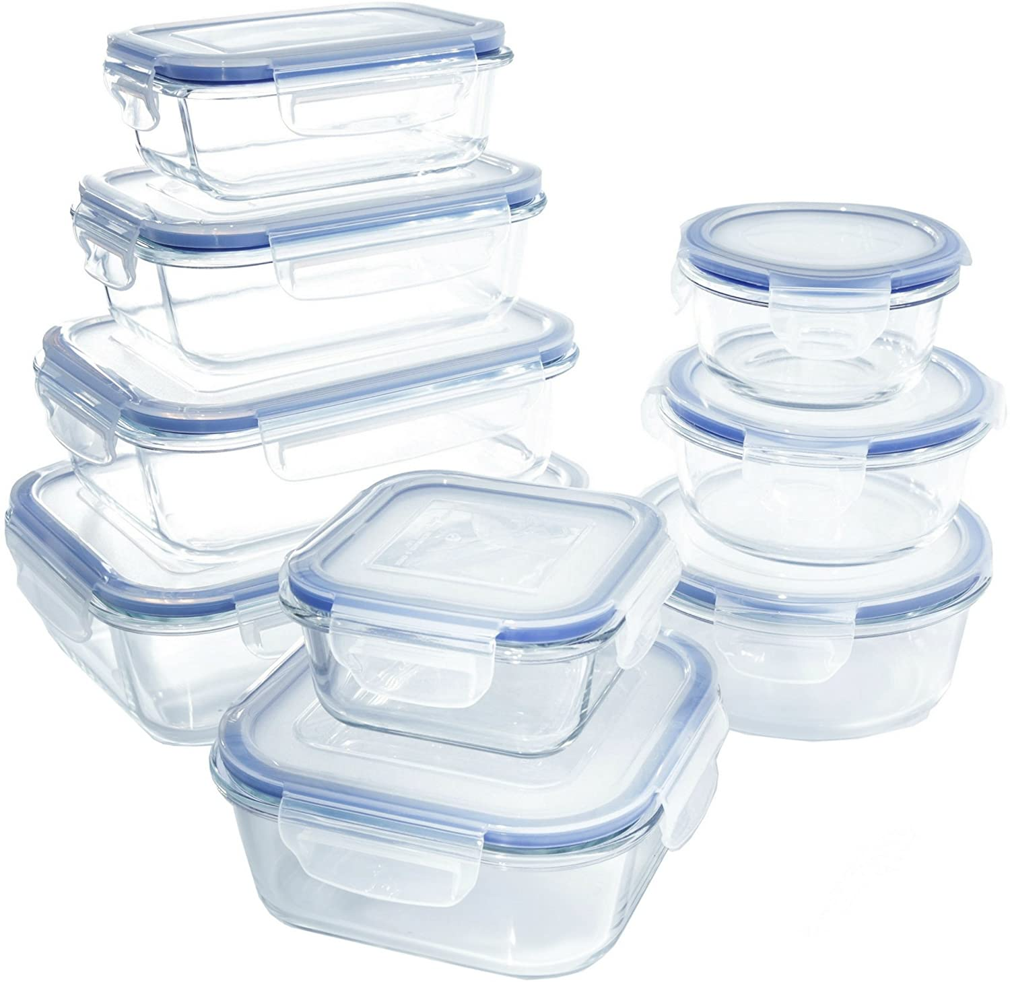


TARGET MARKET
8,75 Bn
3,6 Bn

Slide 7










THE COMPETITION
Food
storage
Drink
storage
Internal
heater
2 in 1
Smart
BPA Free

Slide 8
MARKETING AND SALES
Ad:
-social networks
Selected retailers
BottAll sales
Online store
Customer

Slide 9
FINANCIAL PROJECTION
 | COMPONENTS | 1st YEAR SCALE | COST | PRICE | MARGIN
OPTION 1 (food container) | Case double layered + Cap + Electronic Parts | 3000 units | 30€ | 40€ | 10€
OPTION 2 (water bottle) | Case double layered + Cap | 3000 units | 13€ | 25€ | 12€
OPTION 1+2 (food + water bottle) | Cases double layered + Cap + Electronic Parts | 15000 units | 45€ | 55€ | 10€
 | YEAR 1 | YEAR 2 | YEAR 3 | YEAR 4 | YEAR 5
SALES VOLUMES | 0 | 21K | 35K | 60K | 100K
COSTS | -500K | -800K | -800K | -800K | -800K
REVENUES | 0 | +800K | +1300K | +1800K | +2700K
MARGIN | -500K | -500K | 0 (BEP) | 1000K | 2500K

Slide 10
MILESTONES
January-February 2021 | -Development and design of the product -Setting up company’s board structure
March-April 2021 | -Prototyping -Crowdfunding
May-June-July 2021 | -Facility leasing
July-August 2021 | -Finding partners for manufacturing
September 2021 | -Start of the production
November 2021 | -Go to martket
2022 onward | -Future partnership with some popular brands

Slide 11
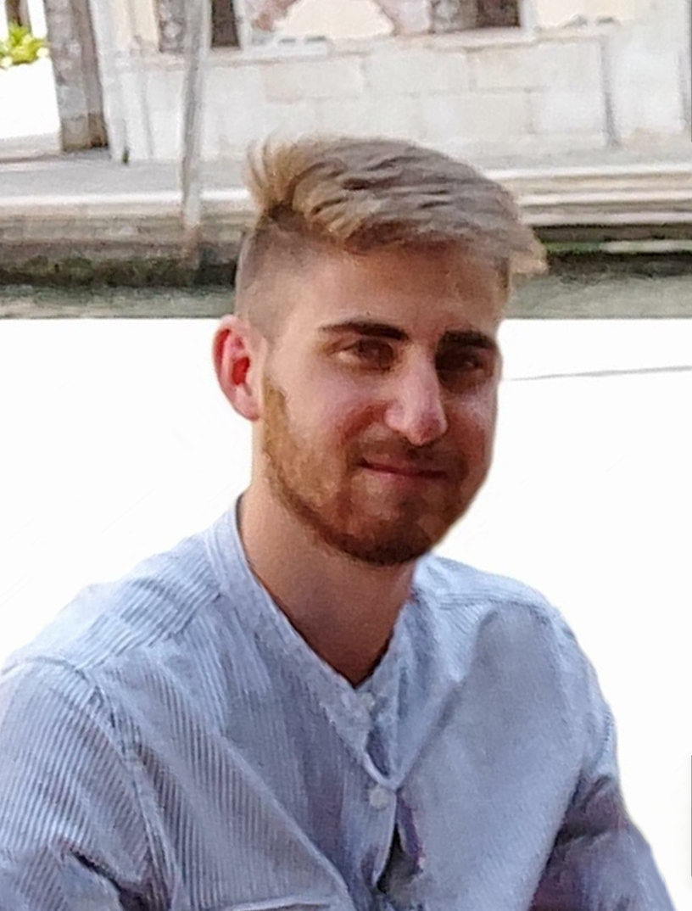
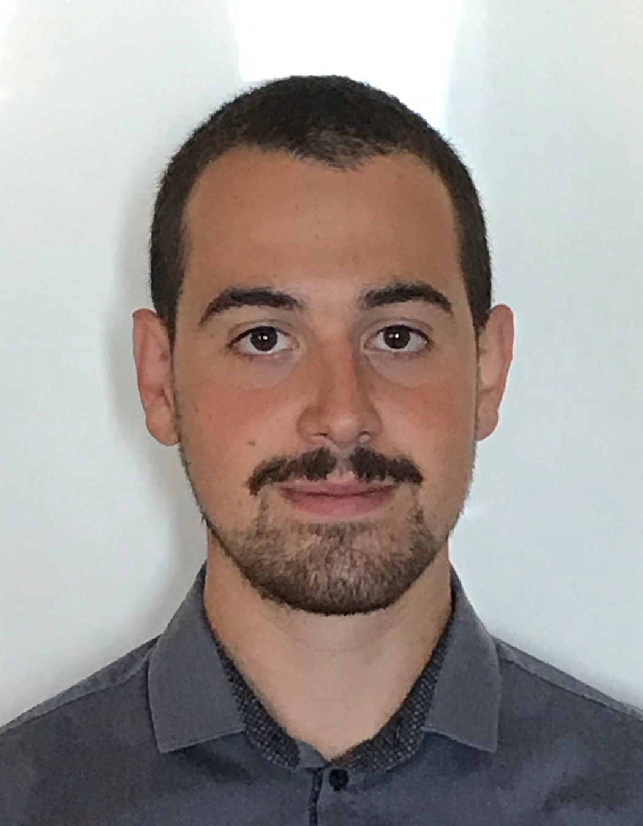
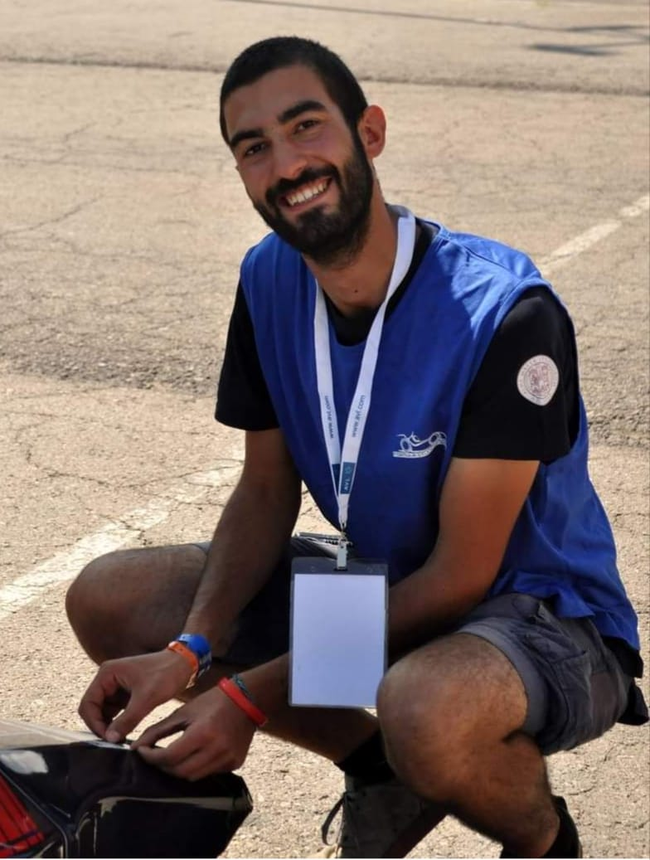
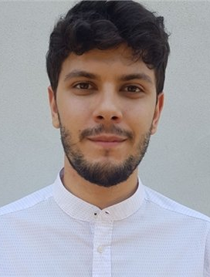
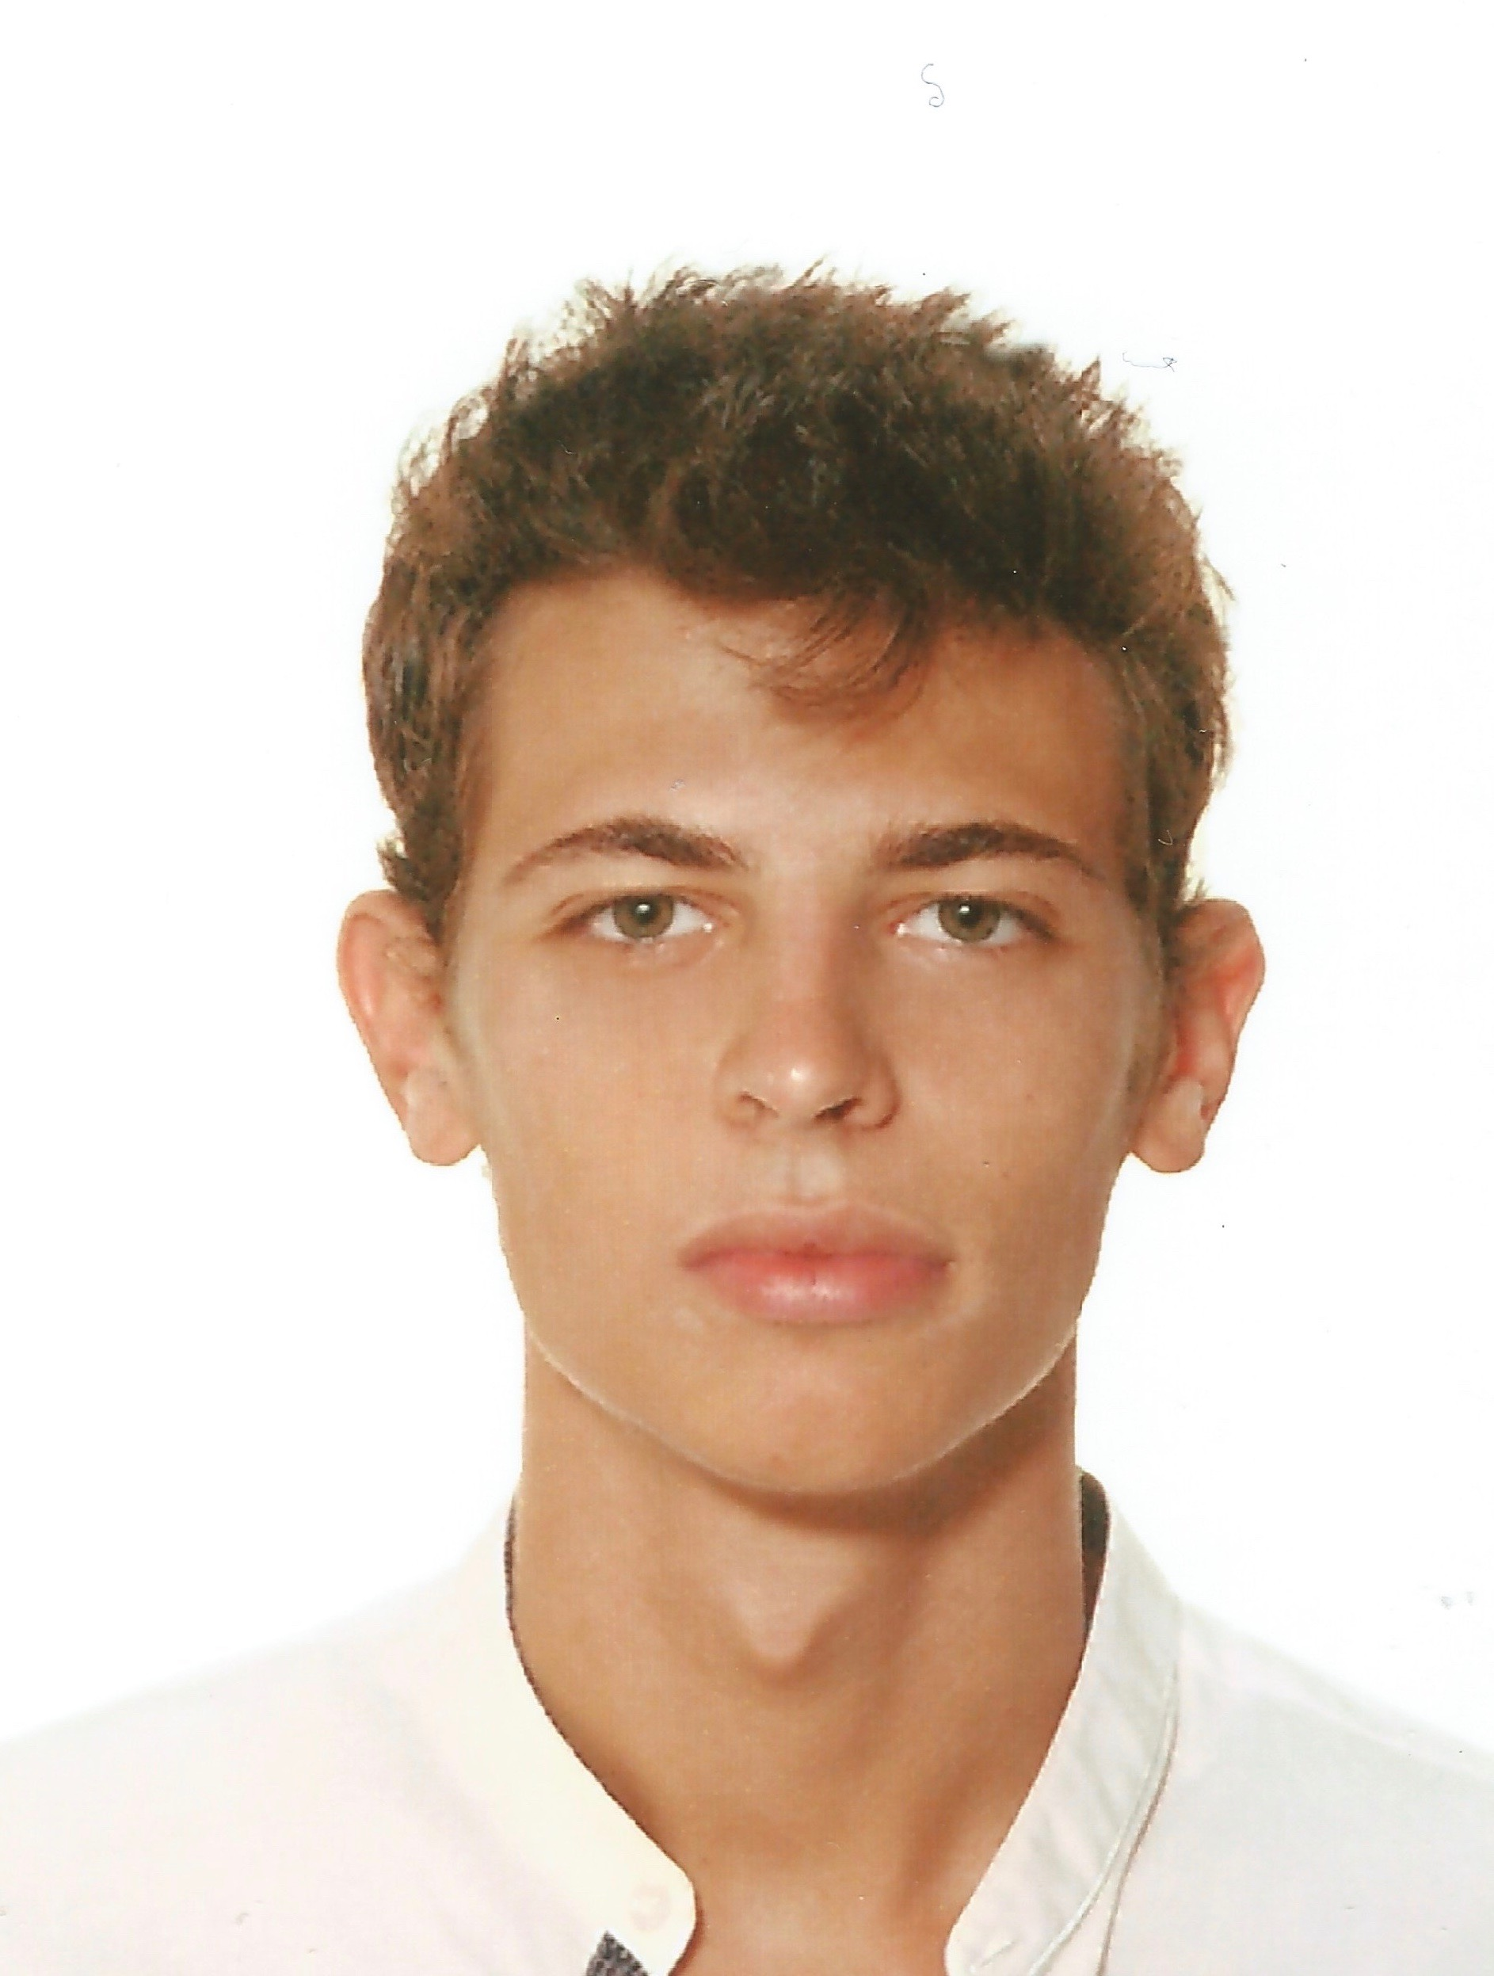
THE TEAM
Francesco Romani
AGE: 22
POSITION: founder
-MSc in Electric Vehicle Engineering, MUNER
-BSc in Energy Engineering, UNIPD
Jacopo Ferretti:
AGE: 22
POSITION: founder
-MSc in Electric Vehicle Engineering, MUNER
-BSc in Computer and Automation Engineering at UNIVPM
Rosario La Rocca
AGE: 25
POSITION: founder
-MSc in Electric Vehicle Engineering, MUNER
-Ex member of formula student project of University of Bologna
Mattia Davario
AGE: 23
POSITION: founder
-MSc in Electric Vehicle Engineering, MUNER
-BSc in Electrical Engineering, UNIBO
Tommaso Bertoncello
AGE: 22
POSITION: founder
-MSc in Electric Vehicle Engineering, MUNER
-BSc in Energy Engineering, UNIPD

Slide 12





SUMMARY
Smart Product
Huge market potential
Know-how
Engineering skills
Thrilled students
Team-working skills

